Slide 1

MOVIE RECOMMENDER SYSTEMS
Team Members
Koukuntla Komal Reddy
Chalumuri Harshitha
Chintada Jagan Mohan Rao Koppaka Yeswanth
Kalapala Venkata Surya Teja
Asif Ahmad Najar
Mentors​
Kanav Bansal​ (Chief Data Scientist)
Vijit Singh (Mentor)

Slide 2
CONTENTS OF THIS PROJECT
Project Overview
Roadmap of the Project
Chosen approaches and justification to building the movie recommendation system
Algorithms and Techniques
Dataset Analysis
Overview of implementation of plan
Conclusion

Slide 3
01
Project Overview
Goals and Objectives of the project

Slide 4
Project Goal
To build a movie recommender system that can recommend movies to users based on their past ratings and preferences.
Project Objectives
To clean and pre-process the data.
To perform exploratory data analysis.
To choose the best machine learning algorithms for the task.
To train the machine learning algorithms on the data.
To make predictions of movies that users are likely to enjoy.
To evaluate the performance of the recommender system.

Slide 5
02
Roadmap
Roadmap of the project

Slide 6
Roadmap
Data cleaning
Data Preprocessing
EDA
Model Building
Model Serialization& Deserialization
Deployment
Report Generation

Slide 7
03
Approaches
Different Approaches in building a movie recommendation system

Slide 8
Types of Recommendation Systems
Popularity based Recommendation system
Content based Recommendation system
Collaborative based Recommendation system
Popularity based Recommendation System
It is a type of recommendation system which works on the principle of popularity and or anything which is in trend. These systems check about the product or movie which are in trend or are most popular among the users and directly recommend those. In this project our popularity rating will be vote count

Slide 9

Approach for popularity based recommendation system
We need a metric to recommend the movie (which is like a scorecard)
According to the scores we recommend best rated movie to users
So IMDB weighted average score is used for recommending the movies
v is the number of votes garnered by the movie
m is the minimum number of votes required for the movie to be in the chart (the prerequisite)
R is the mean rating of the movie from 0 to 10 (mean) = rating
C is the mean of vote_average(rating) of all the movies in the dataset

Slide 10
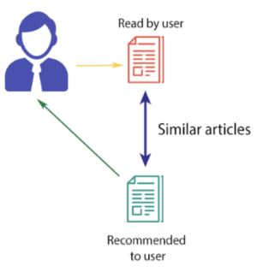
Content based Recommendation System
The algorithm recommends products that are similar to the ones that a user has liked in the past.
Here we recommend according to the content which user has/had been interested in
Hence we need a technique which analyses the content , in other sense text

Slide 11
Approach for content based recommendation system
Among all other vectorisation techniques like Bag of Words, Word2Vec,BERT
We chose TF-IDF considering the following points
The key difference between bag of words and TF-IDF is that the former does not incorporate any sort of inverse document frequency (IDF) and is only a frequency count (TF).
TF-IDF is a statistical measure that we can apply to terms in a document and then use that to form a vector whereas word2vec will produce a vector for a term and then more work may need to be done to convert that set of vectors into a singular vector or other format
BERT uses deep neural networks as part of its architecture which may be very expensive
TF-IDF
The term frequency is frequency measure of a word in a document
Inverse document frequency gives a numeric value of the importance of a word
The product of TF and IDF is the TF-IDF. TF-IDF is usually one of the best metrics to determine if a term is significant to a text. It represents the importance of a word in a particular document

Slide 12
Collaborative based Recommendation System
Based on the combination of the user’s behavior and comparing and contrasting that with other users’ behavior in the database
USER- BASED FILTERING
ITEM- BASED FILTERING
The basic idea here is to find users that have similar past preference patterns as the user ‘A’ has had and then recommending him or her items liked by those similar users which ‘A’ has not encountered yet. This is achieved by making a matrix of items each user has clicked, viewed, rated depending upon the task at hand, and then computing the similarity score between the users and finally recommending items that the concerned user isn’t aware of but users similar to him/her are and liked it
The concept in this case is to find similar movies instead of similar users and then recommending similar movies to that ‘A’ has had in his/her past preferences. This is executed by finding every pair of items that were rated/viewed/liked/clicked by the same user, then measuring the similarity of those rated/viewed/liked/clicked across all user who rated/viewed/liked/clicked both, and finally recommending them based on similarity scores

Slide 13
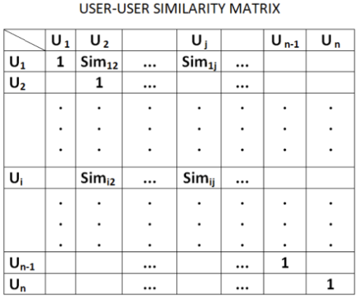
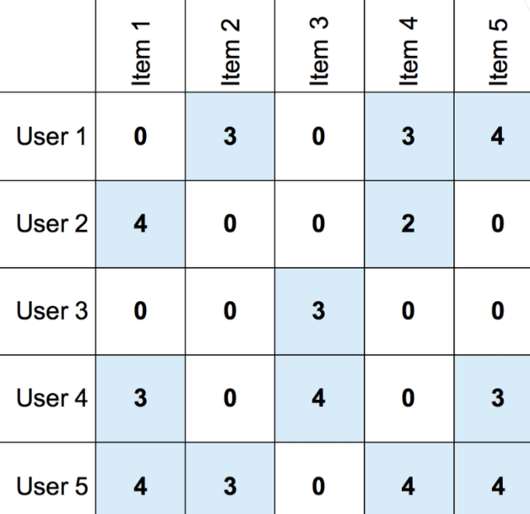
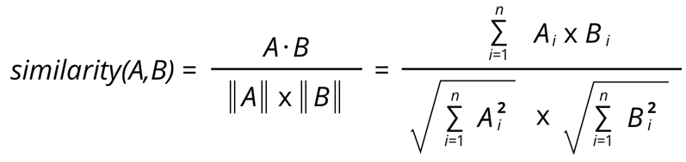
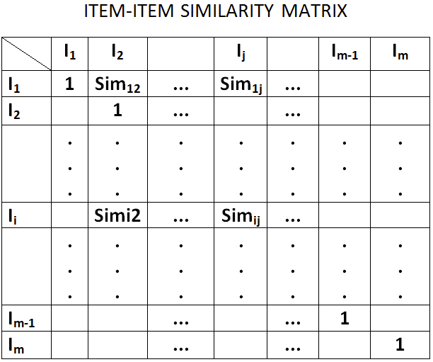
Approach for Collaborative based recommendation system
Key idea is users who agreed in the past tend to also agree in the future
For User-User based filtering we use cosine similarity
Create the Document Term Matrix using CountVectorizer
Convert the sparse matrix into pandas dataframe
Then apply cosine similarity
The same is done for Item-Item based filtering

Slide 14
04
Algorithms and Techniques
Different Techniques in building a movie recommendation system

Slide 15
Techniques used in the project
Popularity based Recommendation systems based on Weighted Rating
Content Based Recommendation system based on NLP concept TF-IDF (term frequency - inverse document frequency)
Collaborative Based Recommendation system based on KNN (K Nearest Neighbors)

Slide 16
05
Dataset Analysis
Analyzing the dataset

Slide 17

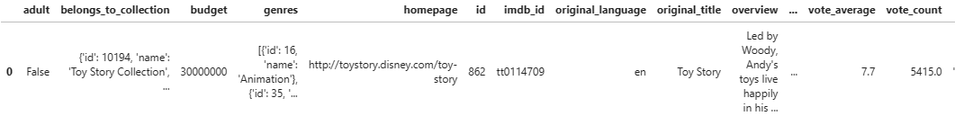
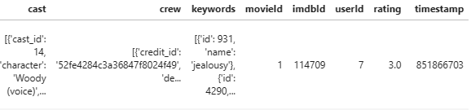
Dataset Analysis
Merging datasets

Slide 18
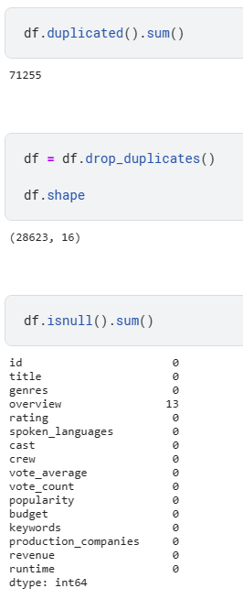
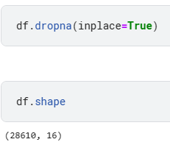
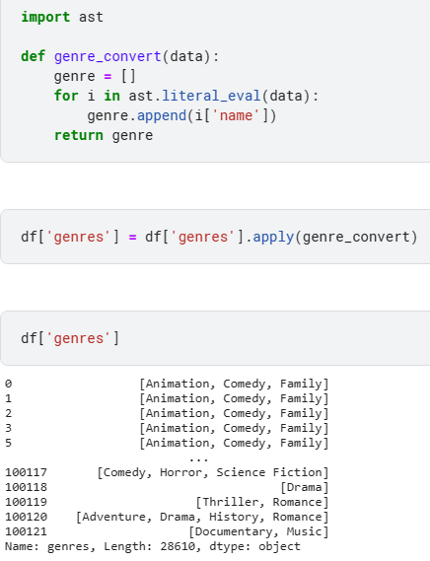
Dropping columns like adult,belongs_to_collection,homepage,imdb_id,original_language,original_title,poster_path,production_countries,release_date,status,tagline,video,movieId,imdbId,userId,timestamp which are not that useful features
Then removing duplicates and converting the object columns into a readable , clean format
We have id name for each genre in our dataset as we are most interested in the name of genre not on its id, we only keep its name by removing the extra unnecessary information

Slide 19
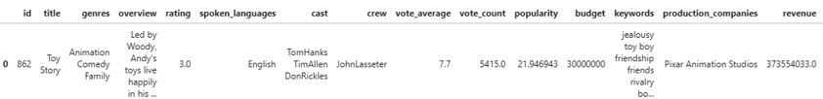


Final Dataset

Slide 20
06
Overview Of Implementation of plan
Timeline of the project

Slide 21
Data cleaning, Data processing, EDA
25th May
Model Building
27th May
Model Serialization and Deserialization
29th May
Deployment
31th May
Report Generation
1st June

Slide 22
07
Conclusion

Slide 23
We would conclude by stating that the recommendation system changed the whole scenario by making it easy for the user to choose their desired choices and of interest. It recommends user personalized content and looked into various types like popularity , content , collaborative based recommendations.
These are few real world implementations that can be applied with the recommender system: 1. Netflix 2. Amazon Prime
3. Youtube Recommendations
4. MovieLens
5. Rotten Tomatoes and many more...

Slide 24
WE
Project manager: @ Koukuntla Komal Reddy
Data scientist: @ Koppaka Yeswanth
Software engineer: @ Chalumuri Harshitha
User experience designer: @ Kalapala Venkata Surya Teja
Documentation writer:@ Asif Ahmad Najar
Quality assurance engineer:@ Chintada Jagan Mohan Rao
AS A TEAM APPRECIATE FOR YOUR VALUABLE TIME, THANK YOU

